Slide 1
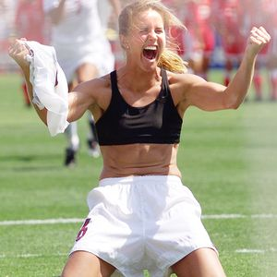
Playing Like a Girl: Women’s Sports and the Media
By: abby massengale
http://www.nndb.com/people/507/000023438/brandi.jpg

Slide 2
Introduction
40% of athletes are females
1.6% of coverage time
Women’s Sports Foundation, 2011
Depicted as wives, mothers, girlfriends (Kane, 2011)
94% of sports editors are men (Klos, 2013)
WHY?

Slide 3
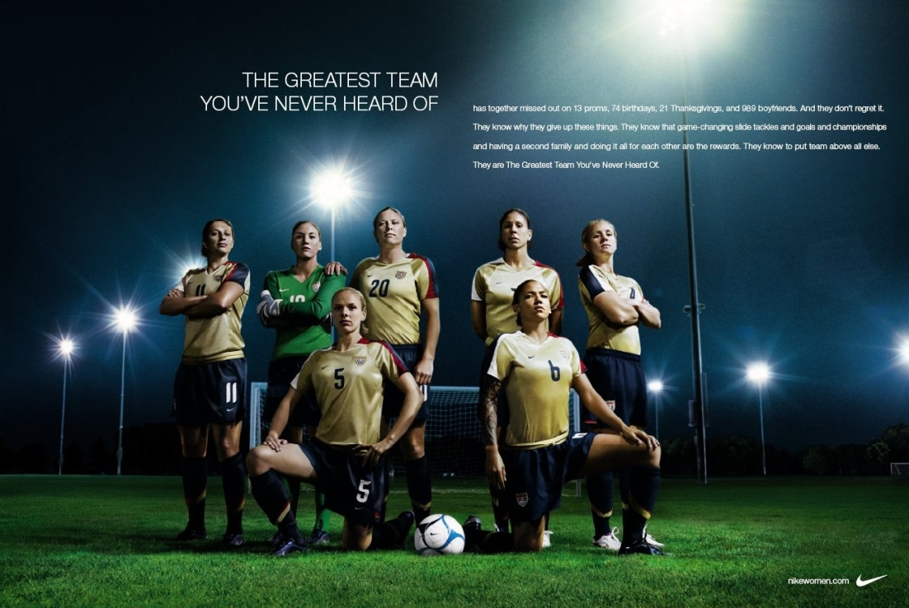
Why Should This Be Researched?
“Giving the people what they want,” (Messner & Cooky, 2010)
Scholars disagree
http://theinspirationroom.com/daily/print/2007/9/nike_greatest_missed.jpg

Slide 4
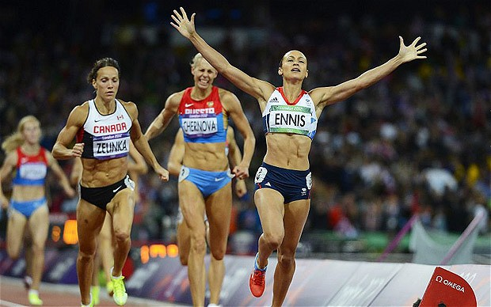
Purpose
Attain primary data from Spring Hill College students on their opinions and reactions on women’s sports and female athletes in the media
http://i.telegraph.co.uk/multimedia/archive/02314/Ennis_2314669b.jpg

Slide 5
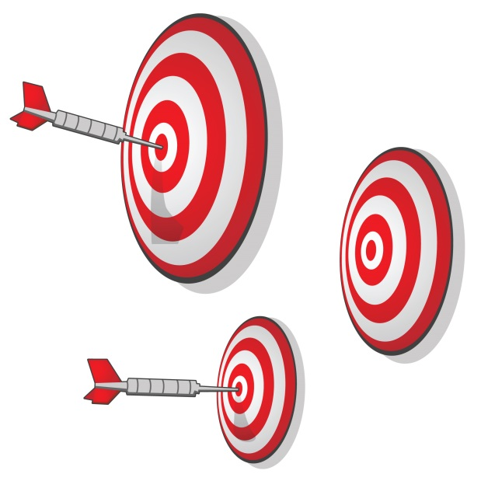
Theoretical Underpinnings
Essentialism (Messner, 2011)
Cultivation Effect Theory (Schroeder, 2005)
http://gallery.mailchimp.com/f4a17ce71fc4bfc0d303a850a/images/darts_on_target_01.jpg

Slide 6
Research Question
What are Spring Hill College students’ opinion and reactions on women’s sports and the depiction of female athletes in the media?
http://s3.amazonaws.com/rapgenius/1365193232_Guy-with-Question-Mark-over-his-headFotolia_102829_XS.jpeg

Slide 7
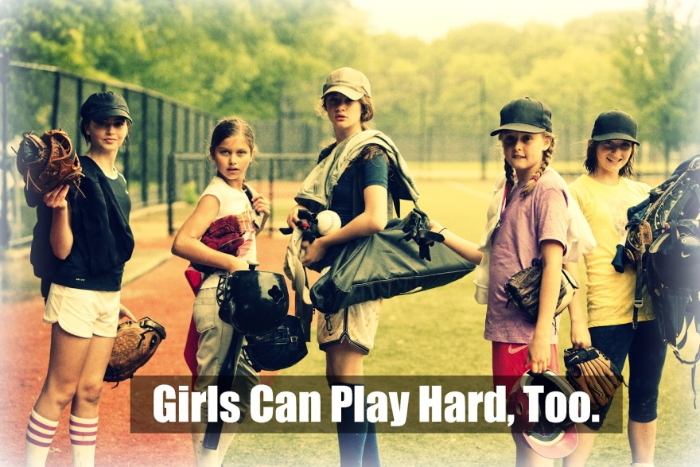
Literature Review: Title IX
Passed in 1972
Equal opportunity
295,000 girls → 3.2 million
980% increase
http://momfavorites.com/wp-content/uploads/blogger/-qQKUBDBttEo/T-pdWIbGe8I/AAAAAAAADfk/0qxCr_RufDQ/s1600/title%2Bix.jpg

Slide 8
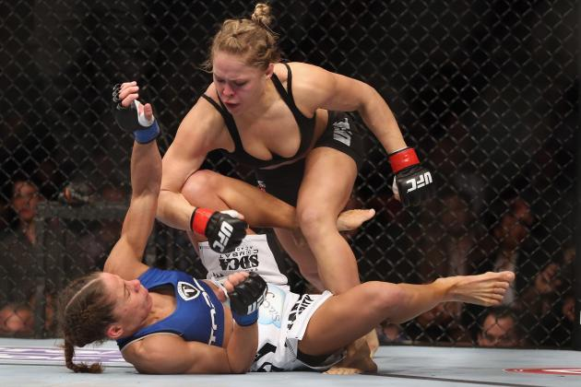
Literature Review: Sports Televised Medium
Declining → 6.3% to 1.6% (Messner & Cooky, 2010)
Cultivation Effect Theory (Schroeder, 2005)
“Sex-appropriate sports” (Fink, 1998)
Media preference → heterosexually attractive women (Goodman et al., 2002)
http://img.bleacherreport.net/img/images/photos/002/175/894/hi-res-162480960_crop_north.jpg?w=630&h=420&q=75

Slide 9
Literature Review: Sports Print Medium
“Re-packing of female athletes” (Messner & Cooky, 2010)
Female athletes associated with attractiveness (Knight & Giuliano, 2001)
Submissive Roles (Goodman et al., 2002)
“Sex sells” (Kane, 2011)
http://snarkerati.com/galleries/Francesca-Piccinini/0009-Francesca-Piccinini.jpg

Slide 10
Literature Review: Sports Advertising Medium
Sexualization of female athletes → hindering
Core demographic for women’s sports = women (Gray, 2011)
Women have a negative response (Abrams, 2012)
Public enjoy “sex appropriate” sports (Cunningham et al., 2008)
http://c4.likes-media.com/img/59bdca49dee650834e34b3631187c4f2.600x

Slide 11
Gender in Sport’s Media
Media construct our belief system (Fink, 1998)
94% of sports editors are male (Klos, 2013)
Research shows that traits associate with sports are also associated with masculinity (Steinfeldt et al., 2011)
Sports bring core societal values to the surface (Messner, 2011)
Essentialism (Messner, 2011)

Slide 12
Methodology
Three focus groups
Spring Hill College students
4 males & 4 females per group →24 total
Facilitator
11 questions & 5 images

Slide 13
Thematic Analysis
Boyatzis, 1998
Two thematic analyses: Opinion & Reaction
Quotations from participants utilized
Opinion
Keywords → Competitive, backlash, anti-climactic, sex appeal
Themes →Positive Opinion (PO), Negative Opinion (NO), Other (O)
Reaction
Keywords → Negative connotations, degrading, hyper feminized
Themes → Positive Reaction (PR), Negative Reaction (NR), Other (O)

Slide 14
Necessary Permissions
IRB Approval →expedited review
Consent Forms
http://www.rickross.com/wp-content/uploads/approved_red_stamp.png

Slide 15
Types of Questions
Why do you think there is more coverage of men’s sports than women’s?
What is more appealing about a women’s volleyball game over a women’s basketball game?
What image stood out most in your mind?

Slide 16
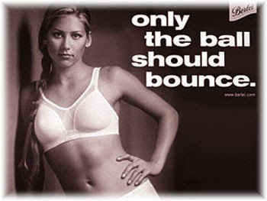
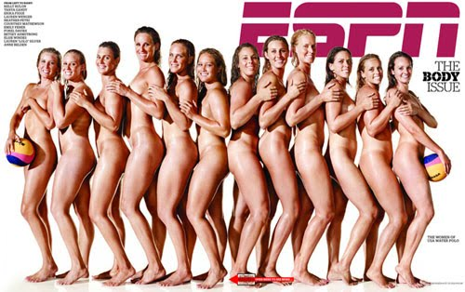
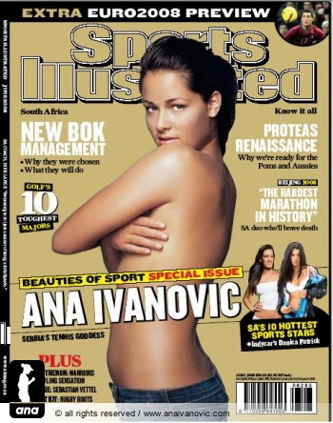
Images Shown

Slide 17
Results
State three adjectives that you would associate with sports
Aggression, strength, physical, competition
Essentialism
Why do you think there is more coverage of men’s sports than women’s?
Faster paced, more physical, more entertaining
Essentialism & Cultivation Effect Theory

Slide 18
Results
The Women’s Sports Foundation found that only 2% of network news and ESPN’s Sportscenter covered female athletic events, how does that make you feel?
First shocked, then justified
Cultivation Effect Theory

Slide 19
Results
What is more appealing about a women’s volleyball game over a women’s basketball game?
Spandex
Not as physical
What image stood out the most to you?

Slide 20
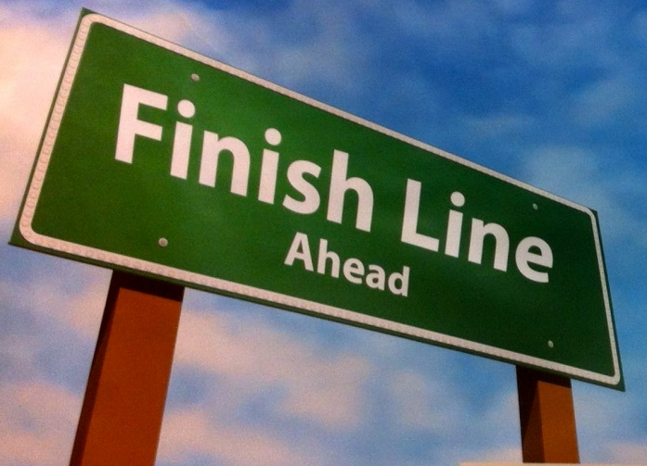
Conclusion
Great increase in participation since Title IX
Still behind in coverage in depiction…why?
Ideologies of dominant gender
http://www.ounewsbureau.com/wp-content/uploads/2013/02/finish-line.jpg

Slide 21
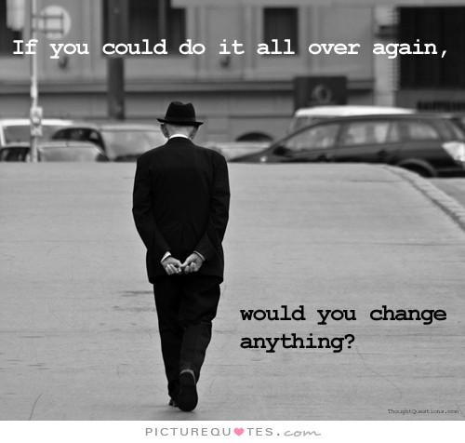
If I could do it again…
More time for research
In-depth interviews
Quantitative Study
http://img.picturequotes.com/2/4/3353/if-you-could-do-it-all-over-again-would-you-change-anything-quote-1.jpg

Slide 22
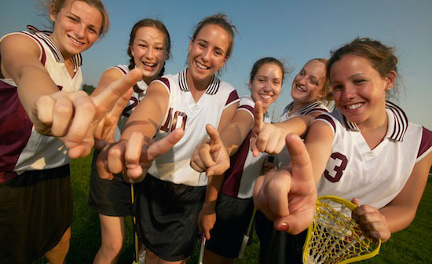
Questions?!
Ask away!
http://www.womenssportsfoundation.org/home/~/media/General/large_meta_data/advocate/advocate_lacrosse_numberone.ashx

